Slide 1
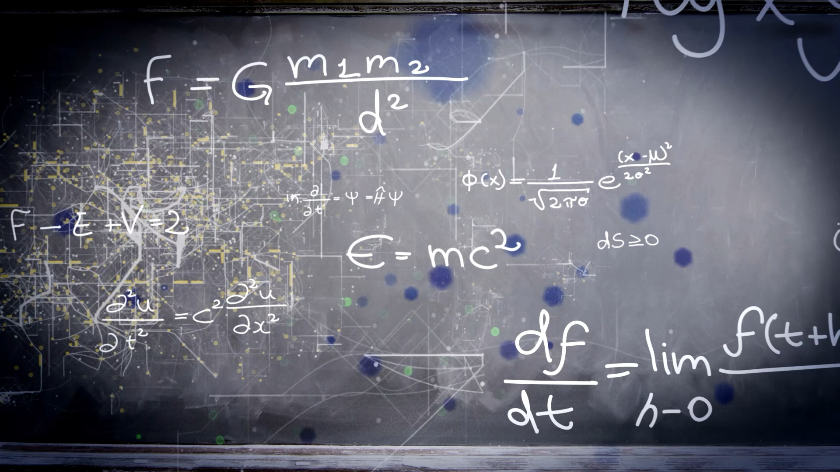
Workshop on fundamental and math's behind networks
Himanshu Singh, Priyanka Bhat, AIIMS, Delhi`

Slide 2

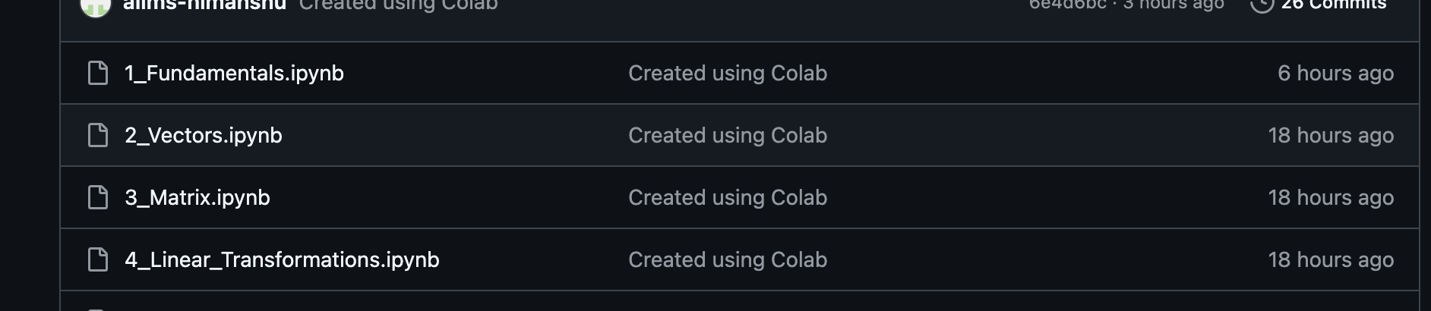

GitHub
List of 8 Google Collab Script
click on .py file (Self paced decide if you know fundamental skip, otherwise go through worksheet)
Open the .py file in google collab (if have linked Gmail should open automatically in browser)
We have curated math's to code and presentable to refresh knowledge.
No programming prerequisite required (you may run from your mobile phone ”Experimental”)
Please feel free to contact Dr. Priyanka, Dr. Esha and Satyajeet

Slide 3
Array NumPy: The foundation of most ML applications. Provides multi-dimensional arrays and functions for fast mathematical computations. Pandas: Extends NumPy arrays by introducing DataFrame structures, making it easier to manipulate and analyze tabular data. TensorFlow and PyTorch: Advanced libraries for deep learning that use multi-dimensional arrays called tensors.
An array is one of the most basic and common data structures used in Machine Learning. It is also used in linear algebra to solve complex mathematical problems.
Arrays as Data Structures in Machine Learning.
Data Storage and Manipulation: In Machine Learning, we get data in various forms like tables, images, audio etc. In most cases arrays serve as the primary data structure to store and manipulate the data. Mainly matrices and tables are represented in the form of array.
Representation of Images: In some cases, arrays can be used for the representation of images as well. In this case, each pixel’s value is stored as an element in a two-dimensional array (for grayscale images) or a three-dimensional array (for colored images). For example, an RGB image of 256x256 pixels is stored as an array of shape (256,256,1).
Time Series and Audio data: Time series data is the data which changes over time, is primarily stored in array, this allows us for an easy manipulation and analysis. This allows us to create models to learn from sequences and patterns in data, same applies to audio data.

Slide 4
Vectors
Standard numbers are the components of a vector. The components show influence in a given direction of the vector.
Mathematicians refer to the visualization of vectors by talking about components in a coordinate system. In a two-dimensional plane, a vector logically has two components, while in a three-dimensional one, it has (you guessed it) three.
Geometrically, a vector often encompasses coordinates in an n-dimensional space (n refers to the quantity of dimensions, for instance, two). It signifies the position of a coordinate in an n-dimensional space.
In the Cartesian coordinate system, vector quantities are represented in a space with an x axis — a horizontal straight line — and a y axis — a vertical straight line that’s perpendicular to the x axis.
Fun facts
A vector is an element of a vector space (also known as a linear space), a geometric object collection with an addition rule and a scalar multiplication rule
It’s an object that looks like a directed line segment (though not all vectors are directed line segments)
When its operations can be interpreted appropriately, it’s considered a vector
Physical quantities that vectors can represent include acceleration, displacement, and velocity

Slide 5
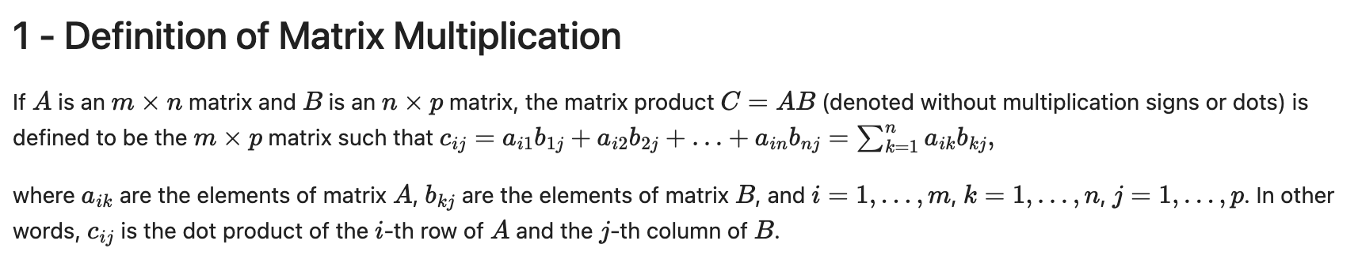
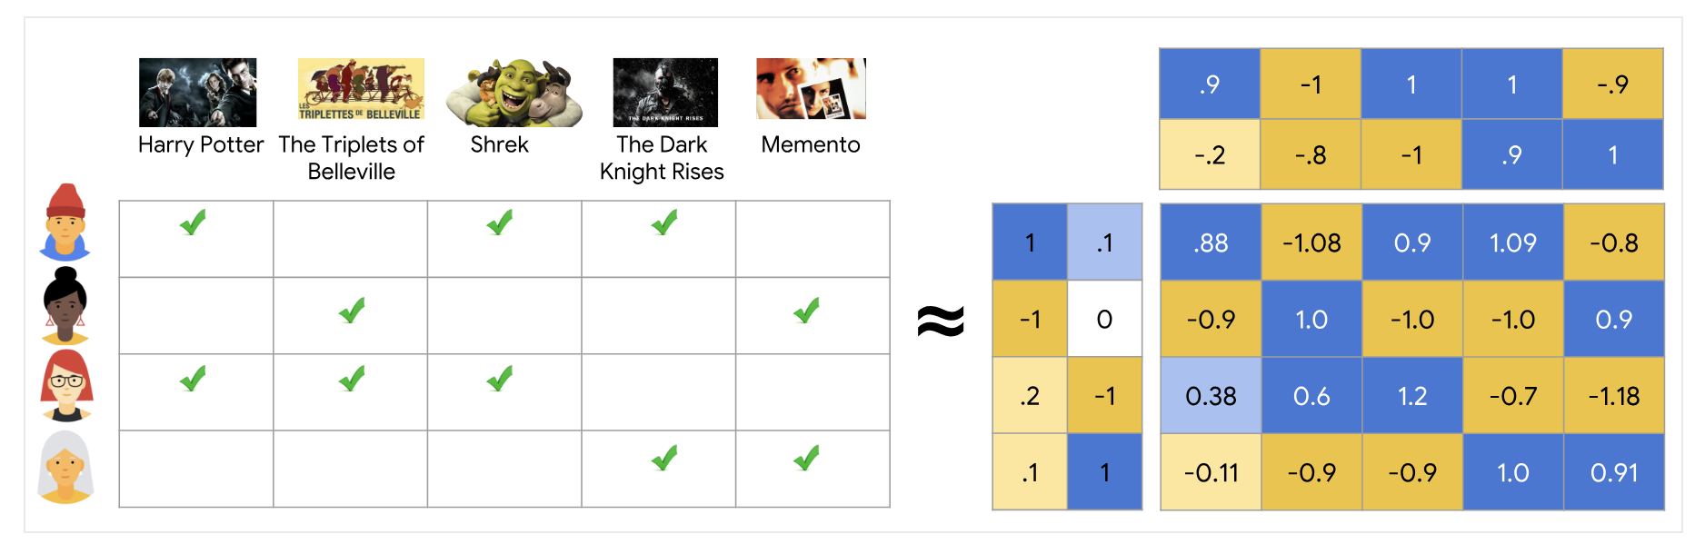
Matrix

Slide 6
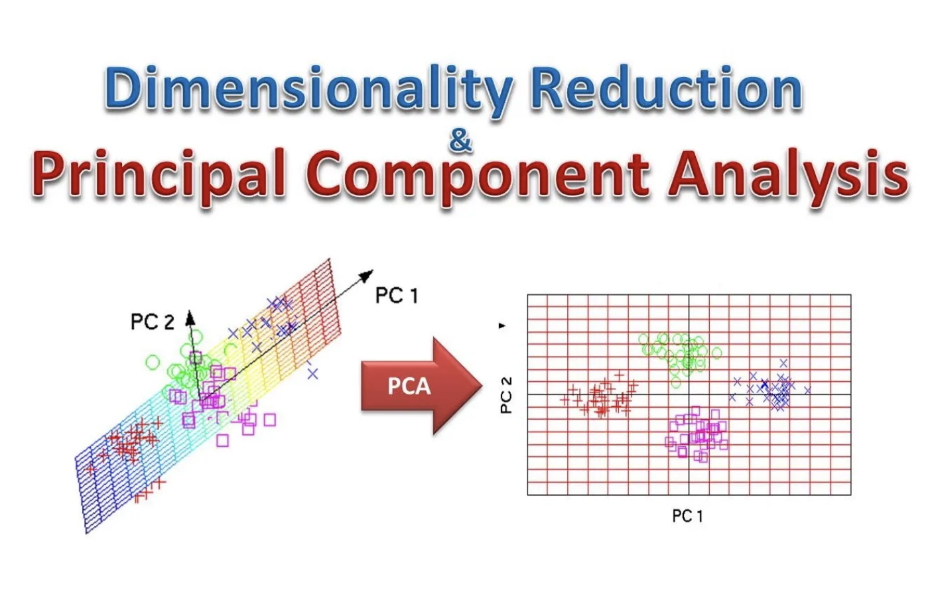
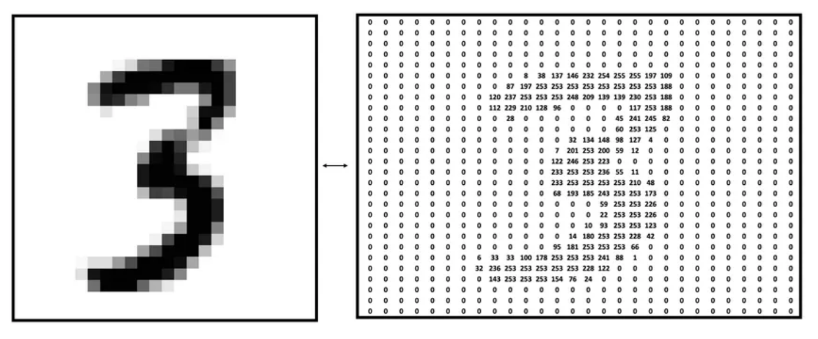
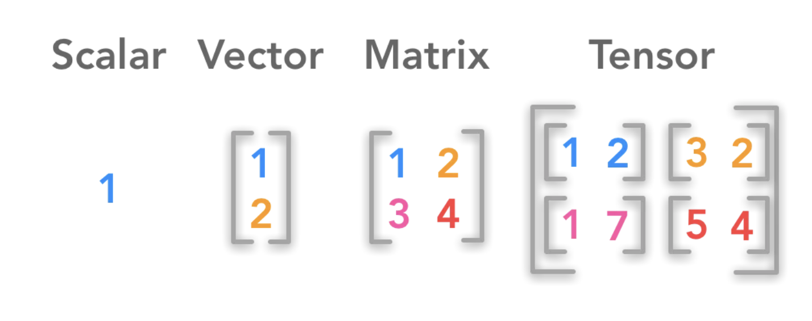
Linear Transformation and matrices

Slide 7
List goes On and On
Differentiation
Gradient Descent
Optimization with global and local minimum
Regression : Linear to Logistics and Neural Networks
Many more (Xgboost, Knn, Tensor and Etc)

